Slide 1

COMPUTER GRAPHICS
Hochiminh city University of Technology
Faculty of Computer Science and Engineering
CHAPTER 7 :
Viewing

Slide 2
OUTLINE
Classical Viewing
Orthographic Projection
Axonometric Projections
Oblique Projection
Perspective Projection
Computer Viewing
View Volume

Slide 3


Classical Viewing

Slide 4
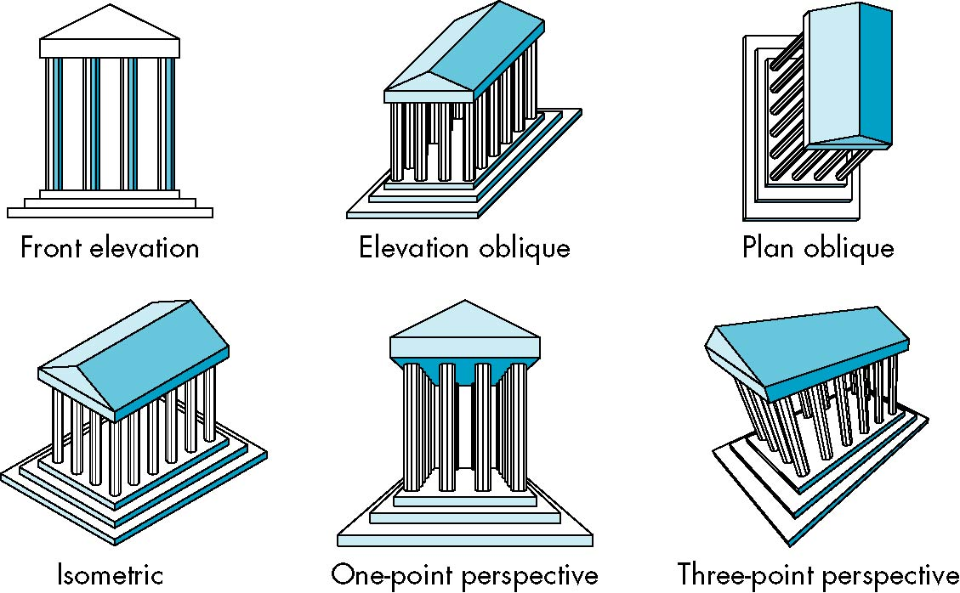
Classical Viewing
Classical Projections

Slide 5
Classical Viewing
Taxonomy of Planar Geometric Projections
planar geometric projections
parallel
perspective
1 point
2 point
3 point
multiview
orthographic
axonometric
oblique
isometric
dimetric
trimetric

Slide 6
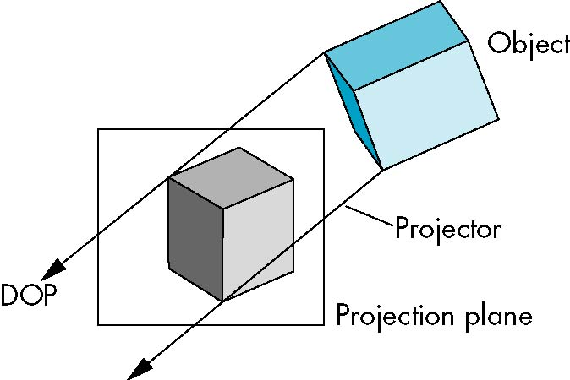
Classical Viewing
Parallel Projection

Slide 7
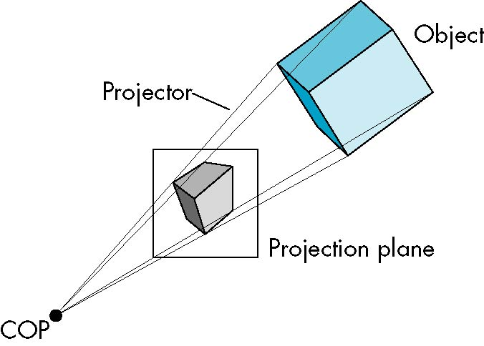
Classical Viewing
Perspective Projection

Slide 8
Classical Viewing
Taxonomy of Planar Geometric Projections
planar geometric projections
parallel
perspective
1 point
2 point
3 point
multiview
orthographic
axonometric
oblique
isometric
dimetric
trimetric

Slide 9

Orthographic Projection
Multiview Orthographic Projection
Projection plane parallel to principal face
Usually form front, top, side views
isometric (not multiview
orthographic view)
front
in CAD and architecture,
we often display three
multiviews plus isometric
side
top

Slide 10
Orthographic Projection
Advantages
Preserves both distances and angles
Shapes preserved
Can be used for measurements
Building plans
Manuals
Disadvantages
Cannot see what object really looks like because many surfaces hidden from view
Often we add the isometric

Slide 11
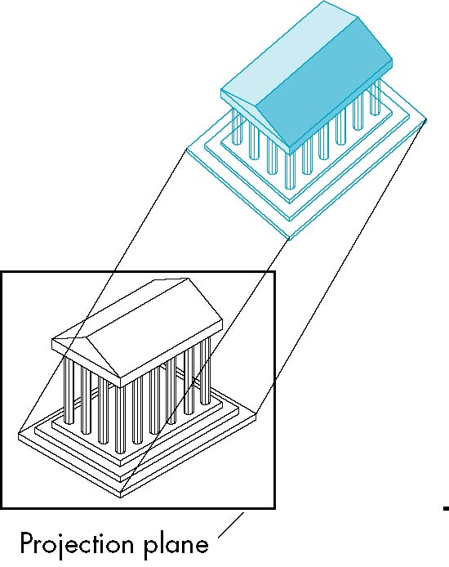
Axonometric Projections
Allow projection plane to move relative to object
Classify by how many angles of a corner of a projected cube are the same
none: trimetric
two: dimetric
three: isometric(trục đo – đều)

Slide 12
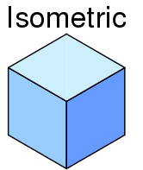
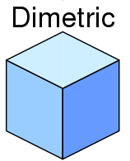
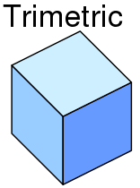
Axonometric Projections
y
H
O
x
z

Slide 13
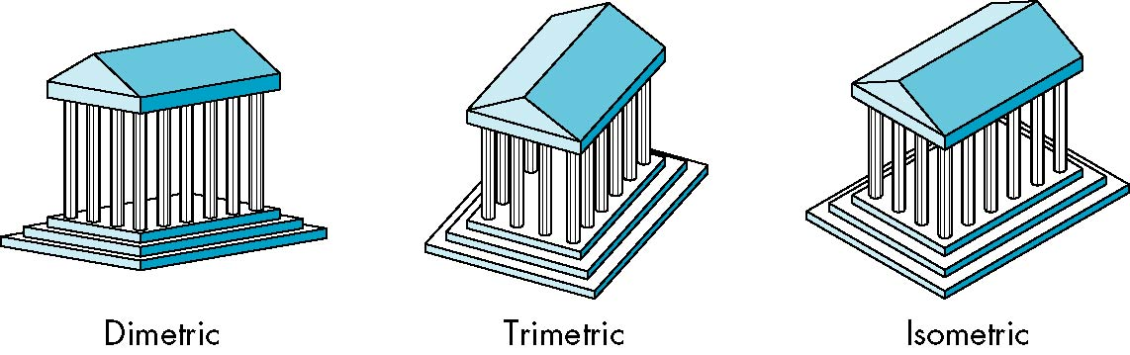
Axonometric Projections

Slide 14
Axonometric Projections
Lines are scaled (foreshortened) but can find scaling factors
Lines preserved but angles are not
Projection of a circle in a plane not parallel to the projection plane is an ellipse
Can see three principal faces of a box-like object
Some optical illusions possible
Parallel lines appear to diverge
Does not look real because far objects are scaled the same as near objects
Used in CAD applications

Slide 15
Classical Viewing
Taxonomy of Planar Geometric Projections
planar geometric projections
parallel
perspective
1 point
2 point
3 point
multiview
orthographic
axonometric
oblique
isometric
dimetric
trimetric

Slide 16
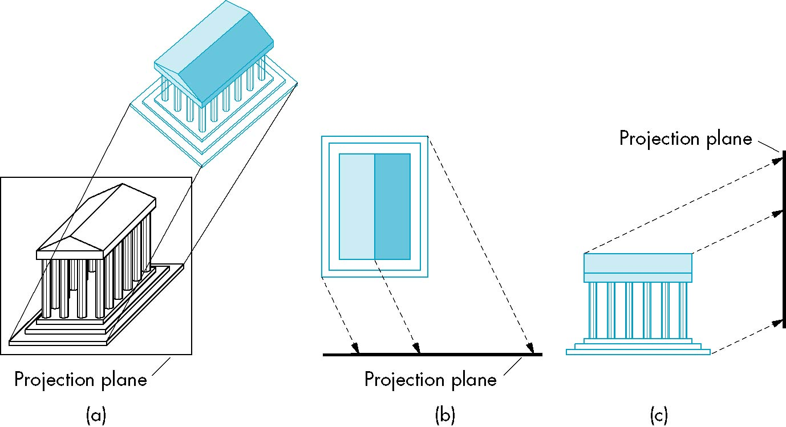
Oblique Projection
Arbitrary relationship between projectors and projection plane

Slide 17
Oblique Projection
Can pick the angles to emphasize a particular face
Architecture: plan oblique, elevation oblique
Angles in faces parallel to projection plane are preserved while we can still see “around” side
In physical world, cannot create with simple camera; possible with bellows camera or special lens (architectural)

Slide 18
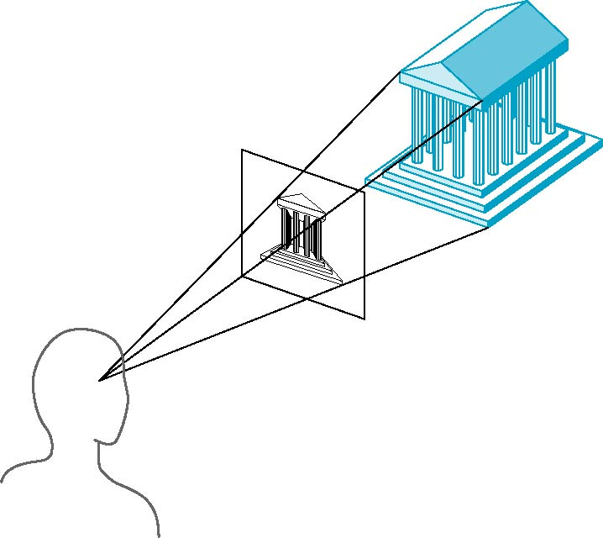
Perspective Projection
Projectors coverge at center of projection

Slide 19
Perspective Projection
Vanishing Points
Parallel lines (not parallel to the projection plan) on the object converge at a single point in the projection (the vanishing point)
Drawing simple perspectives by hand uses these vanishing point(s)
vanishing point

Slide 20
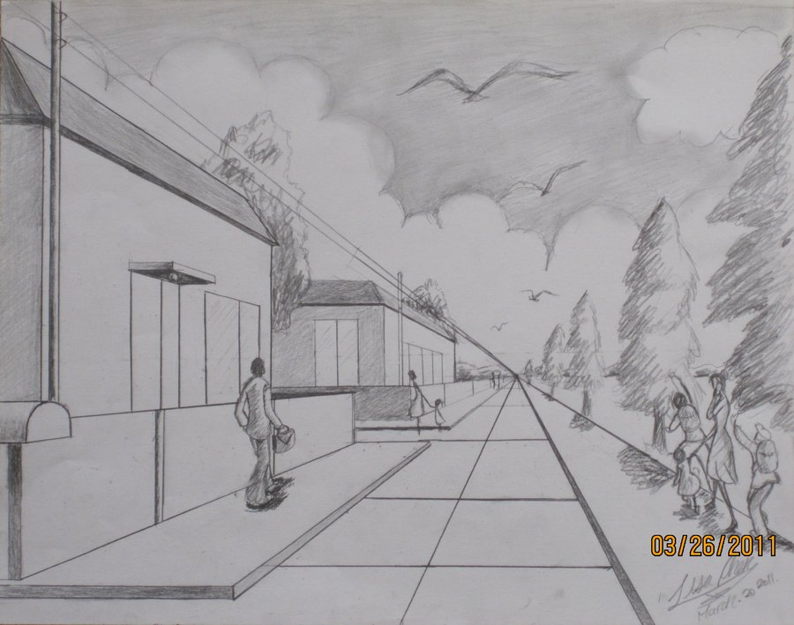
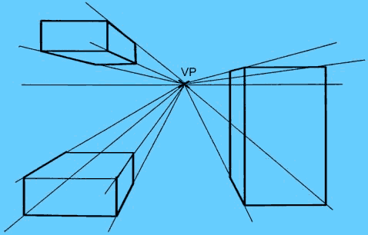
Perspective Projection
One-Point Perspective
One principal face parallel to projection plane
One vanishing point for cube

Slide 21
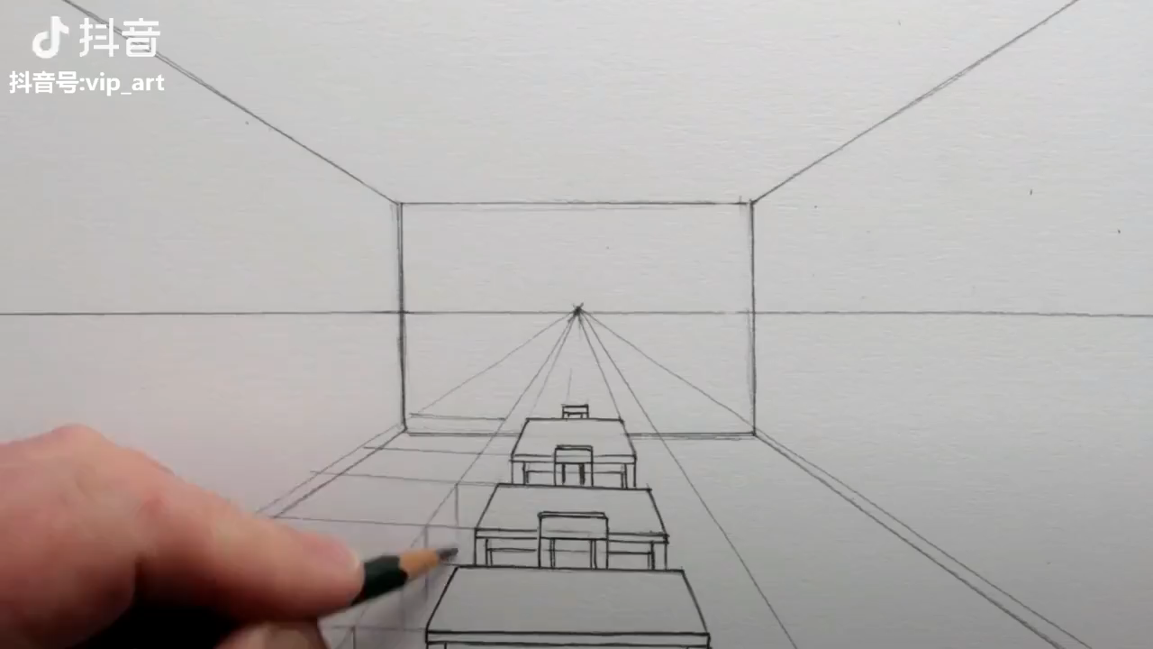
Perspective Projection

Slide 22
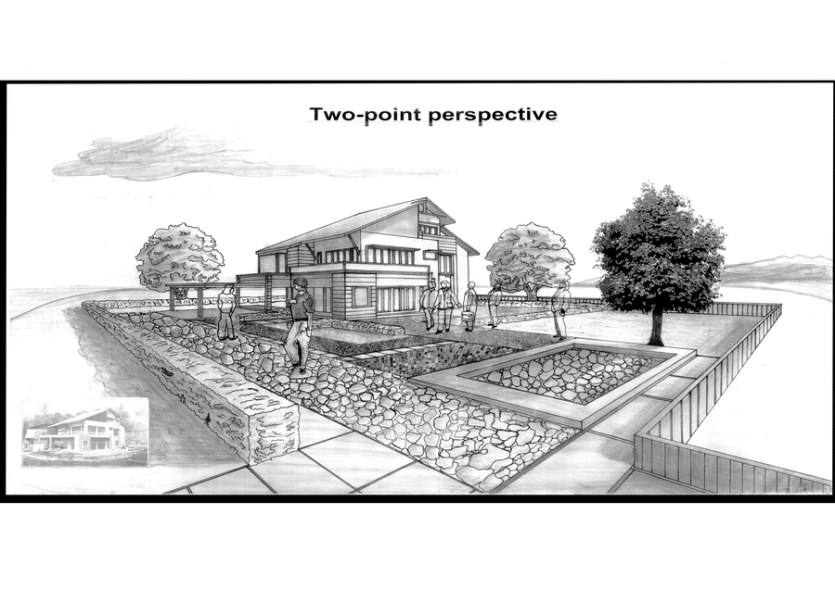
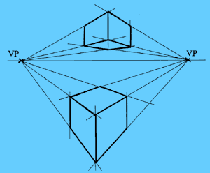
Perspective Projection
Two-Point Perspective
On principal direction parallel to projection plane
Two vanishing points for cube

Slide 23
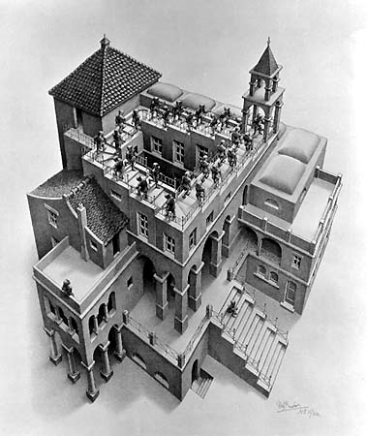
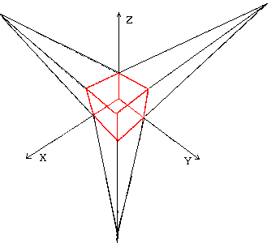
Perspective Projection
Three-Point Perspective
No principal face parallel to projection plane
Three vanishing points for cube

Slide 24
Perspective Projection
Objects further from viewer are projected smaller than the same sized objects closer to the viewer (diminution)
Looks realistic
Equal distances along a line are not projected into equal distances (nonuniform foreshortening)
Angles preserved only in planes parallel to the projection plane
More difficult to construct by hand than parallel projections (but not more difficult by computer)

Slide 25
Computer Viewing
There are two aspects of the viewing process, all of which are implemented in the pipeline,
Positioning the camera
Setting the model-view matrix
Selecting the view volume
Setting the projection matrix

Slide 26
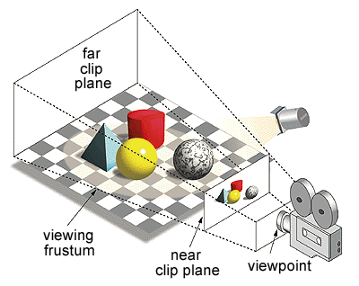
Computer Viewing

Slide 27
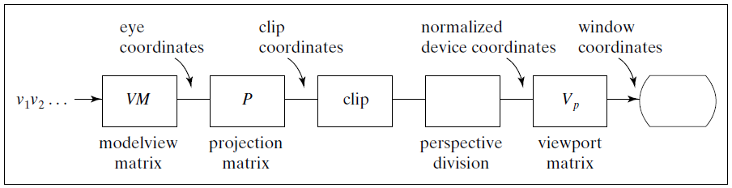
Computer Viewing
Model
View

Slide 28
Computer Viewing
In OpenGL, initially the object and camera frames are the same
Default model-view matrix is an identity
The camera is located at origin and points in the negative z direction
OpenGL also specifies a default view volume that is a cube with sides of length 2 centered at the origin
Default projection matrix is an identity

Slide 29
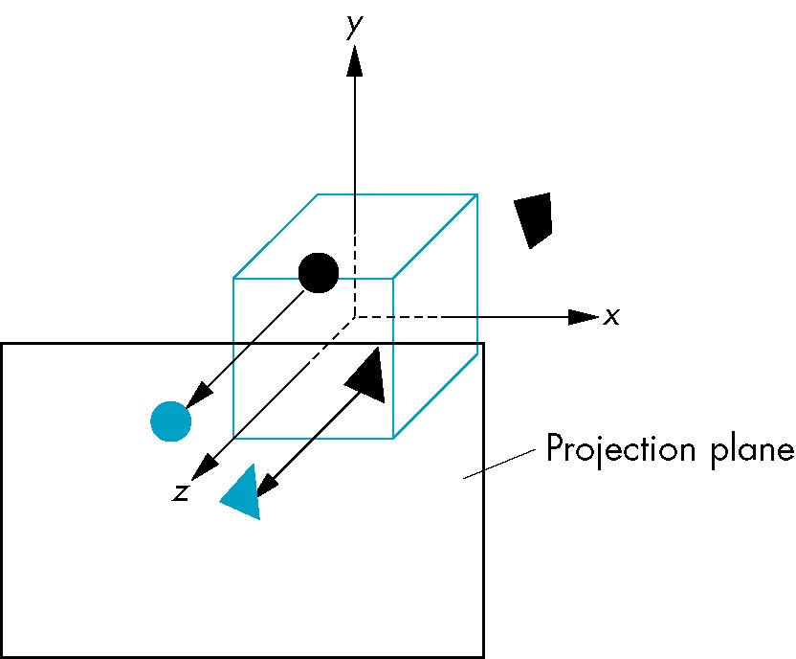

Computer Viewing
Default projection is orthogonal
clipped out
z=0

Slide 30
Computer Viewing
 | Orthographic | Oblique | Perspective
Position, direction (V) | gluLookAt
View Volume (P) | glOrtho |  | glFrustum or gluPerspective
Model
View

Slide 31
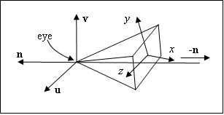
Computer Viewing
Set up position & direction of camera
glMatrixMode(GL_MODELVIEW);
glLoadIdentity();
gluLookAt(eye.x,eye.y,eye.z,look.x,look.y,look.z,
up.x,u p.y,up.z);

Slide 32
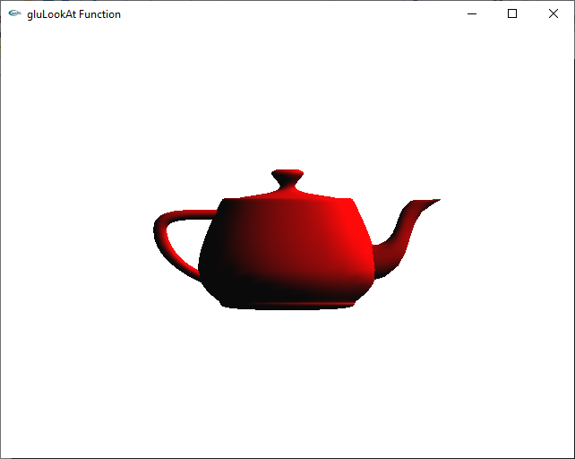


Computer Viewing
Set up position & direction of camera
gluLookAt(0, 0, 10, 0.0, 0.0, 0.0, 0.0, 1.0, 0.0);
y
Look at
eye
x
up
z

Slide 33
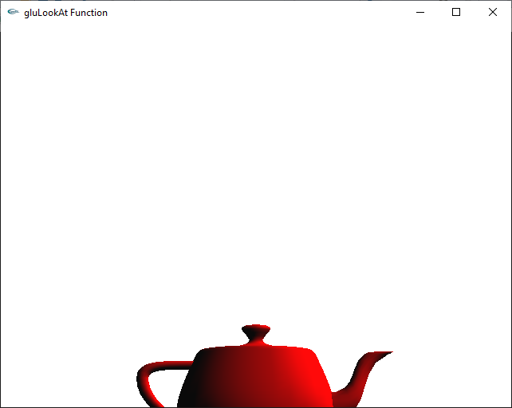

Computer Viewing
Set up position & direction of camera
gluLookAt(0, 0, 10, 0.0, 1.0, 0.0, 0.0, 1.0, 0.0);
y
Look at
eye
x
up
z

Slide 34
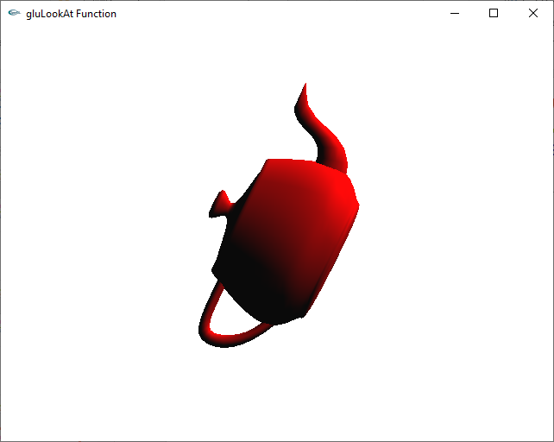
Computer Viewing
Set up position & direction of camera
gluLookAt(0, 0, 10, 0.0, 0.0, 0.0, 2.0, 1.0, 0.0);
y
Look at
eye
x
up
z

Slide 35
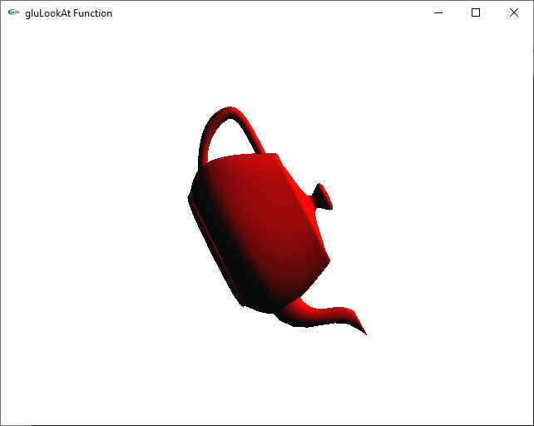
Computer Viewing
Set up position & direction of camera
gluLookAt(0, 0, 10, 0.0, 0.0, 0.0, -2.0, 1.0, 0.0);
y
Look at
eye
x
up
z

Slide 36
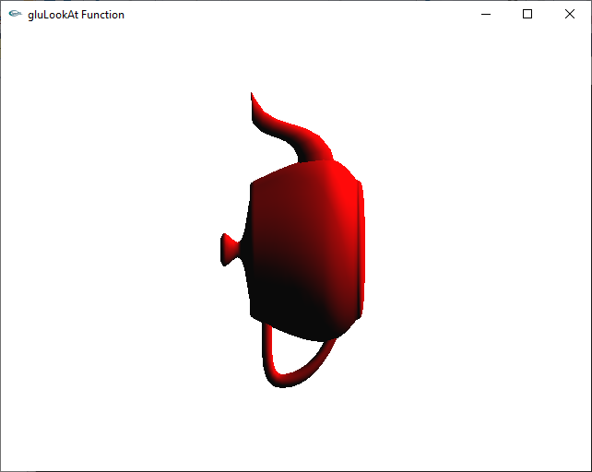
Computer Viewing
Set up position & direction of camera
gluLookAt(0, 0, 10, 0.0, 0.0, 0.0, 1.0, 0.0, 0.0);
y
Look at
eye
x
up
z

Slide 37
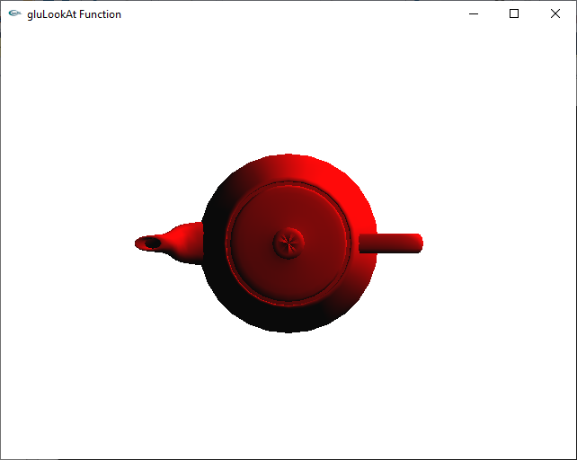
Computer Viewing
Set up position & direction of camera
gluLookAt(0, 10, 0, 0.0, 0.0, 0.0, 0, 0, 1);

Slide 38
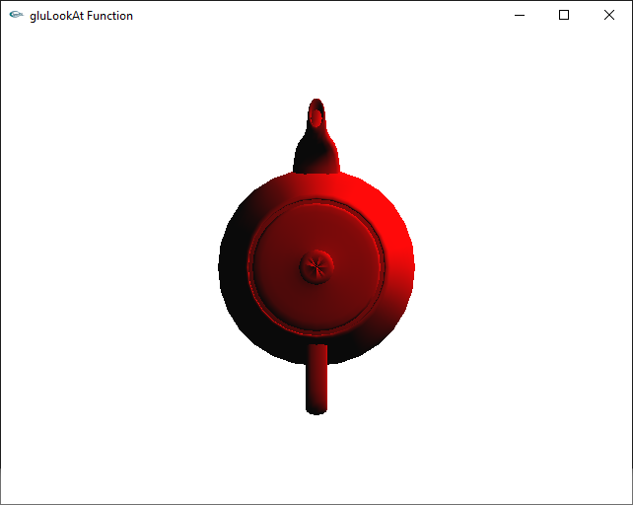
Computer Viewing
Set up position & direction of camera
gluLookAt(0, 10, 0, 0.0, 0.0, 0.0, 1, 0, 0);

Slide 39
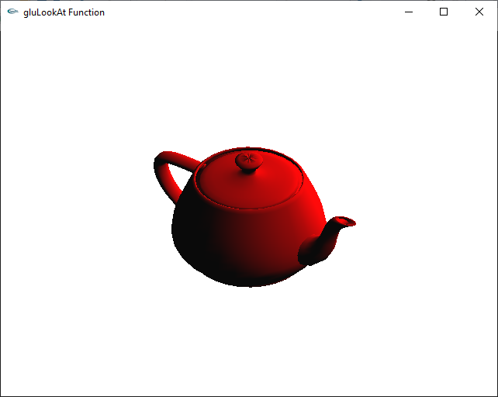
Computer Viewing
Set up position & direction of camera
gluLookAt(6, 7, 8, 0.0, 0.0, 0.0, 0, 1, 0);

Slide 40
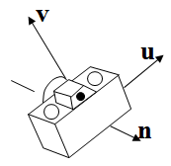
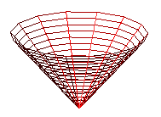
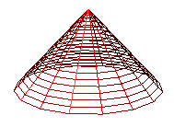
Computer Viewing
y
y’
x’
v
u
z’
eye
n
z
x

Slide 41
Computer Viewing
Orthogonal projection
The default projection in the eye (camera) frame is orthogonal
For points within the default view volume
x_{p} = x
y_{p} = y
z_{p} = 0

Slide 42
Computer Viewing
Orthogonal projection
default orthographic projection
x_{p} = x
y_{p} = y
z_{p} = 0
w_{p} = 1
p_{p} = Mp
M =

Slide 43
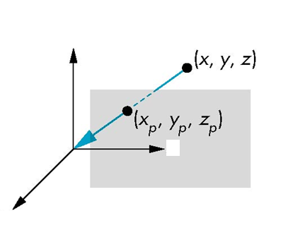
Computer Viewing
Perspective Projection
Center of projection at the origin
Projection plane n = d, d < 0
v
u
n

Slide 44
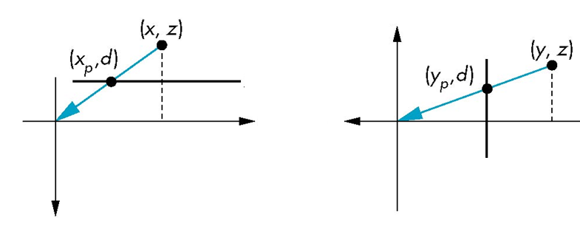
Computer Viewing
Perspective Projection
Consider top and side views
v
n=d
n
u
n=d
n
x_{p} =
y_{p} =
z_{p} = d

Slide 45
Computer Viewing
Perspective Projection
consider q = Mp where
M =
p =
⇒ q =

Slide 46
Computer Viewing
Perspective Projection
However w ≠ 1, so we must divide by w to return from homogeneous coordinates
This perspective division yields
the desired perspective equations
x_{p} =
y_{p} =
z_{p} = d

Slide 47
Computer Viewing

Slide 48

Computer Viewing
gluLookAt(eye.x,eye.y,eye.z,look.x,look.y,look.z,
up.x,u p.y,up.z);
y
v
v
n
n
x
z

Slide 49
Computer Viewing
Matrix transfrom from wordld frame to camera frame
eye, look at, up → u, v, n
n = eye – look.
u = up×n,
v = n×u
u, v, n : unit vector
v
up
up
n
eye
eye
look
u
look

Slide 50
Computer Viewing
Matrix transfrom from world frame to camera frame
CTM = V.M
(d_{x}, d_{y}, d_{z}) = (-eye • u, -eye • v, -eye • n)
v
n
u
y
V
eye
z
x

Slide 51
View Volume
 | Orthographic | Oblique | Perspective
Position, direction (V) | gluLookAt
View Volume (P) | glOrtho |  | glFrustum or gluPerspective

Slide 52
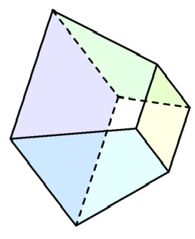
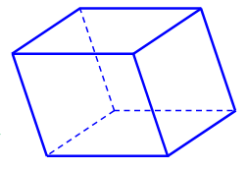
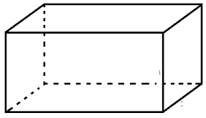
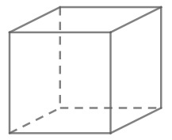
View Volume
Projection Matrix P
× P
View Volume: CCV
Ortho. Projection

Slide 53
View Volume
A
A’
C
C’
× P
B
B’

Slide 54
View Volume
Perspective division: divide by w component
(x, y, z, w) → (x/w, y/w, z/w, 1)

Slide 55
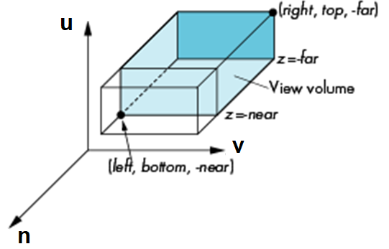
View volume
Orthogonal projection
glOrtho(left,right,bottom,top,near,far)
near and far measured from camera

Slide 56
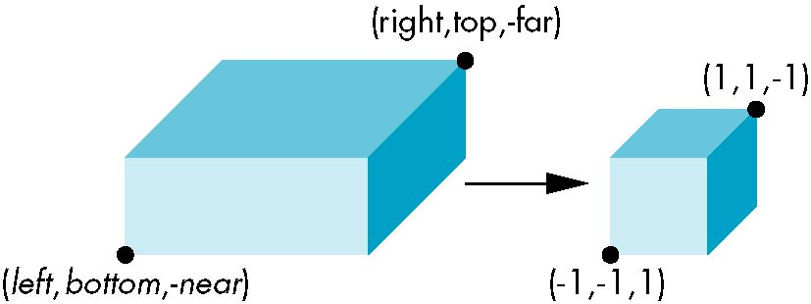
Orthogonal Projection
glOrtho(left,right,bottom,top,near,far)
normalization ⇒ find transformation to convert specified clipping volume to default
Flip: -far → 1; -near → 1
0 < near < far

Slide 57
Orthogonal Projection
Two steps
Move center to origin
T(-(left+right)/2, -(bottom+top)/2,(near+far)/2))
Scale to have sides of length 2
S(2/(right-left),2/(top-bottom),2/(near-far))
P = ST =

Slide 58
Orthogonal Projection
Set up projection matrix in the pipeline
Method 1
glMatrixMode(GL_PROJECTION);
glLoadIdentity();
glOrtho(-1.2, 1.2, -1.2, 1.2, 0.1, 100);

Slide 59
Orthogonal Projection
Set up projection matrix in the pipeline
Method 2
float m[16];
…………………..//Calculate m
glMatrixMode(GL_PROJECTION);
glLoadMatrixf(m);

Slide 60
Orthogonal Projection
Set up projection matrix in the pipeline
Method 3
glMatrixMode(GL_PROJECTION);
glLoadIdentity();
…………… //Calculate S matrix
glMultMatrixf(s);
…………… //Calculate T matrix
glMultMatrixf(t);

Slide 61
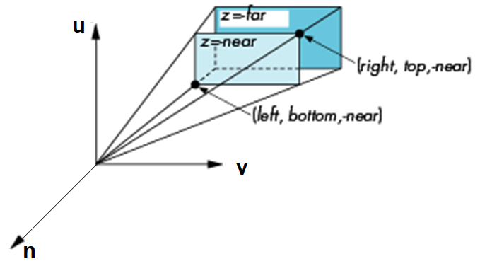
Perspective Projection
Perspective Projection
glFrustum(left,right,bottom,top,near,far)

Slide 62
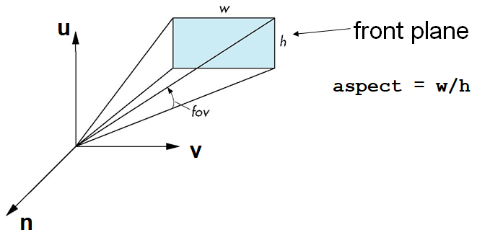
Perspective Projection
Perspective Projection
With glFrustum it is often difficult to get the desired view
gluPerpective(fovy, aspect, near, far) often provides a better interface

Slide 63
Perspective Projection
0 < near < far

Slide 64
Oblique Projections
The OpenGL projection functions cannot produce general parallel projections such as
However if we look at the example of the cube it appears that the cube has been sheared
Oblique Projection = Shear + Orthogonal Projection

Slide 65
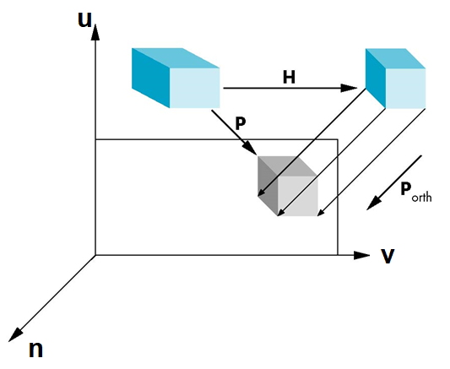
Oblique Projections

Slide 66
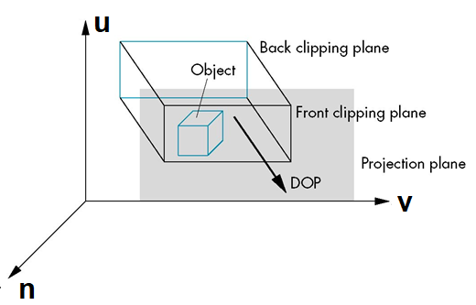
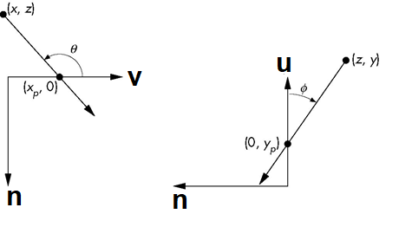
Oblique Projections
top view
side view

Slide 67
Oblique Projections
Shear matrix
xy shear (z values unchanged)
Projection matrix
H(θ,φ) =
P = M_{orth} H(θ,φ)

Slide 68
Further Reading
“Interactive Computer Graphics: A Topdown Approach Using OpenGL”, Edward Angel
Chapter 5: Viewing
“Đồ họa máy tính trong không gian ba chiều”, Trần Giang Sơn
Phép nhìn trong không gian ba chiều

